Slide 1
The Aussies Supremacy
TEST CRICKET

Slide 2
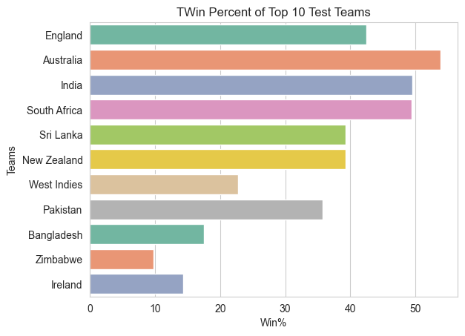




TOP AMOND WIN PERCENT
53.81%
49.52%
42.43%

Slide 3
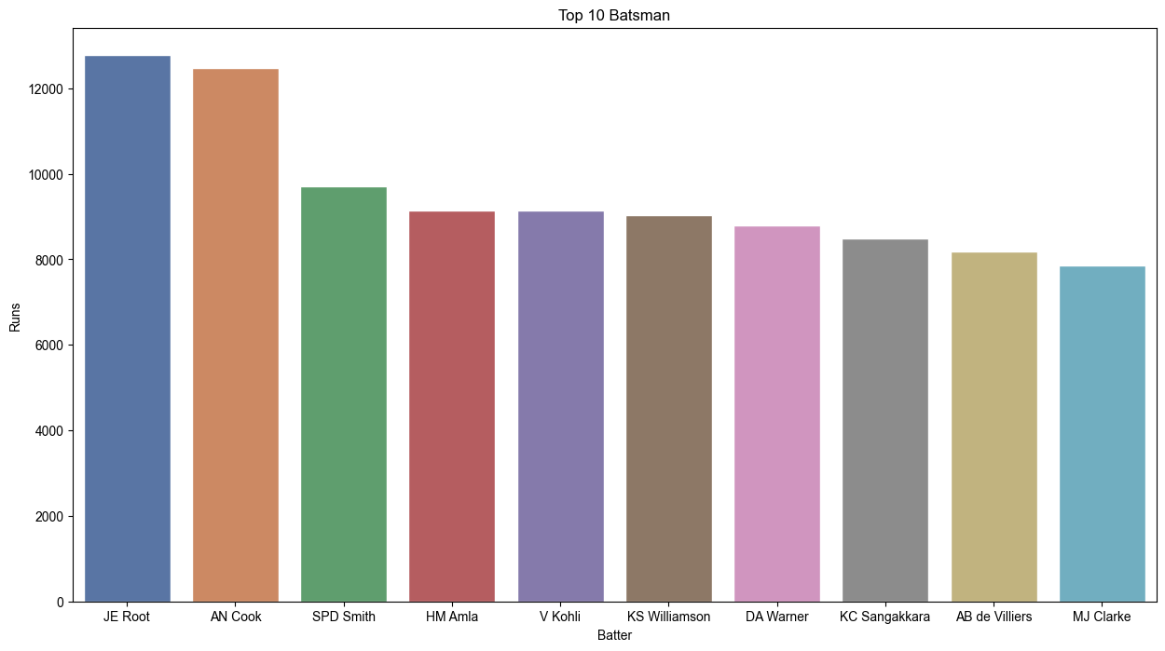
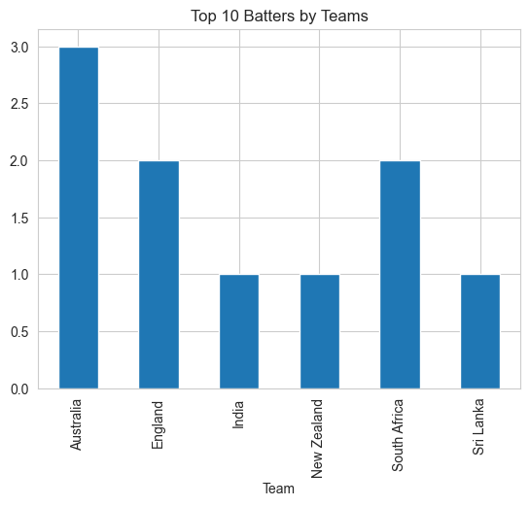
TOP 10 BATTERS
3 OUT OF 10 TOP TEST SCORERS IN ALL TEST MATCHES FROM AUSTRALIA

Slide 4
TOP 10 BATTERS
 | Batter | Team | Runs
0 | JE Root | England | 12777
1 | AN Cook | England | 12472
2 | SPD Smith | Australia | 9702
3 | HM Amla | South Africa | 9146
4 | V Kohli | India | 9145
5 | KS Williamson | New Zealand | 9035
6 | DA Warner | Australia | 8786
7 | KC Sangakkara | Sri Lanka | 8489
8 | AB de Villiers | South Africa | 8182
9 | MJ Clarke | Australia | 7857
3 OUT OF 10 TOP TEST SCORERS IN ALL TEST MATCHES FROM AUSTRALIA

Slide 5
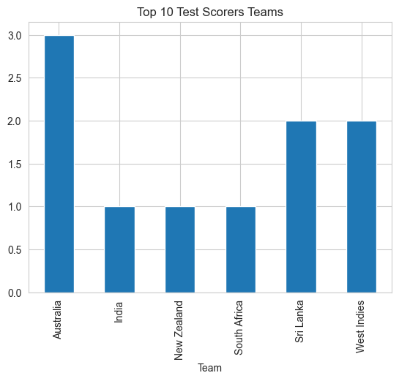
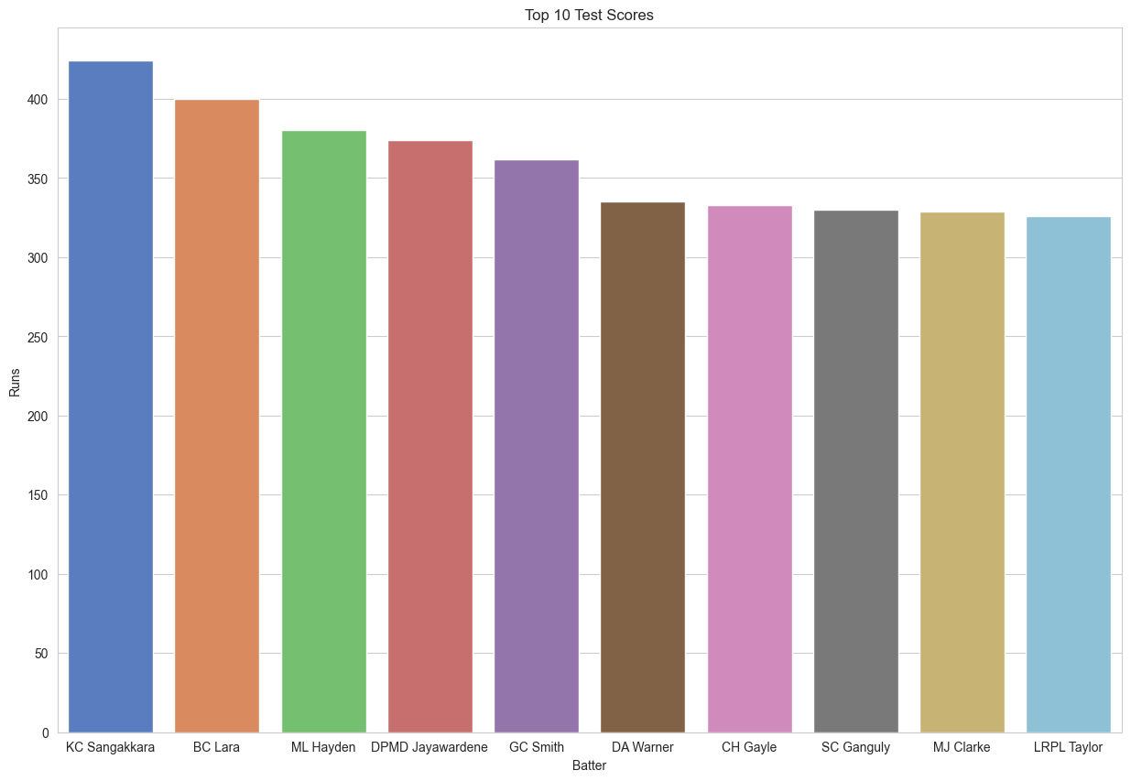
TOP 10 TEST SCORES
3 OUT OF 10 TOP TEST SCORERS IN ONE MATCH FROM AUSTRALIA

Slide 6
TOP 10 TEST SCORES
Batter | Team | Runs
KC Sangakkara | Sri Lanka | 424
BC Lara | West Indies | 400
ML Hayden | Australia | 380
DPMD Jayawardene | Sri Lanka | 374
GC Smith | South Africa | 362
DA Warner | Australia | 335
CH Gayle | West Indies | 333
SC Ganguly | India | 330
MJ Clarke | Australia | 329
LRPL Taylor | New Zealand | 326
3 OUT OF 10 TOP TEST SCORERS IN ONE MATCH FROM AUSTRALIA

Slide 7
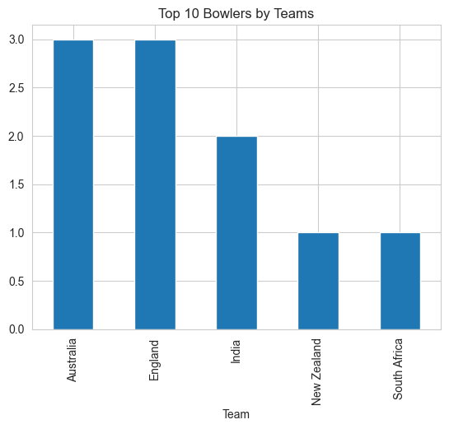
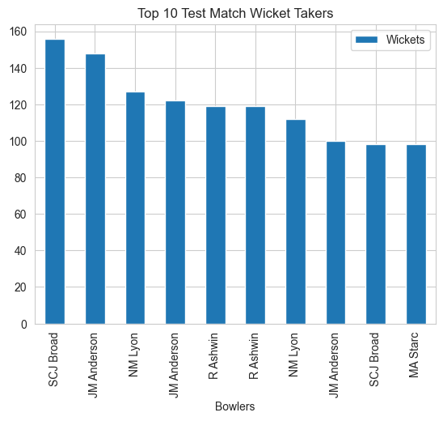
TOP 10 WICKET TAKERS
3 OUT OF 10 TOP TEST WICKET TAKERS FROM AUSTRALIA

Slide 8
TOP 10 WICKET TAKERS
Bowlers | Team | Wickets
SCJ Broad | Australia | 156
JM Anderson | India | 148
NM Lyon | India | 127
JM Anderson | Australia | 122
R Ashwin | Australia | 119
R Ashwin | England | 119
NM Lyon | England | 112
JM Anderson | South Africa | 100
SCJ Broad | New Zealand | 98
MA Starc | England | 98
3 OUT OF 10 TOP TEST WICKET TAKERS FROM AUSTRALIA

Slide 9
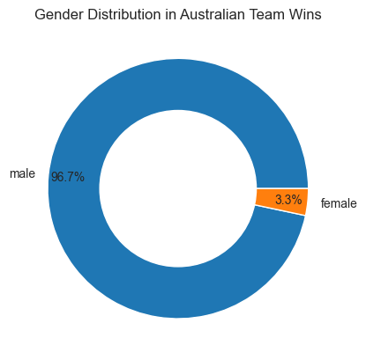

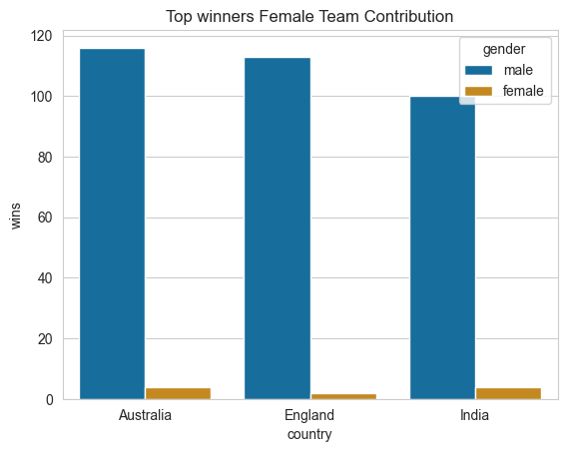
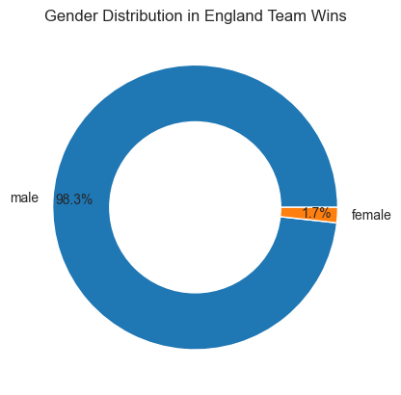
WINNERS
<
3.3% OF ALL MATCHES WON BY FEMALE CRICKET TEAM

Slide 10
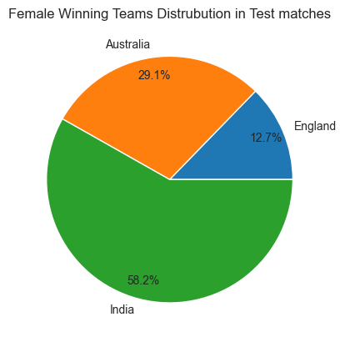
AUSTRALIAN FEMALE TEAM IS AMONG TOP 3 TEST MATCH WINNERS
 | Teams | Matches | Wins | Win%
1 | India | 7 | 4 | 57.1429
2 | Australia | 14 | 4 | 28.5714
3 | England | 16 | 2 | 12.5000
But Indian women’s team topping the charts
in Win Percent

